Slide 1
20CS2220RA Design and Analysis of Algorithms
Session – 8
Introduction to Divide and Conquer
Merge Sort

Slide 2
Divide and Conquer
Divide: Divide the unsorted list into sub lists of about half the size.
Conquer: Sort each of the two sub lists recursively until we have list sizes of length 1, in which case the list itself is returned.
Combine: Merge the two-sorted sub lists into one sorted list.

Slide 3
Merge Sort: Idea
Divide into
two halves
A
FirstPart
SecondPart
Recursively sort
Recursively sort
FirstPart
SecondPart
Merge
A is sorted!
Final sorted list
Notes:
Divide: if the initial array A has at least two elements (nothing needs to be done if A has zero or one elements), divide A into two subarrays each containing about half of the elements of A.
Conquer: sort the two subarrays using Merge Sort.
Combine: merging the two sorted subarray into one sorted array

Slide 4
Merge Sort
Base Case, solve the problem directly if it is small enough(only one element).
Divide the problem into two or more similar and smaller subproblems.
Recursively solve the subproblems.
Combine solutions to the subproblems.

Slide 5
Merge Sort: Algorithm
Algorithm MergeSort ( low, high)
// a[low: high] is a global array to be sorted.
// Small(P) is true if there is only one element to sort. In this case the list is already sorted.
{
if ( low<high ) then // if there are more than one element
{
// Divide P into sub problems.
// Find where to split the set.
mid := [(low+high)/2];
Recursive Calls

Slide 6
//solve the sub problems.
MergeSort(low,mid);
MergeSort(mid+1, high);
// Combine the solutions.
Merge(low, mid, high);
}
}

Slide 7
Algorithm Merge(low, mid, high)
// a[low:high] is a global array containing two sorted subsets in
a[low:mid]
// and in a[mid+1:high]. The goal is to merge these two sets into a single set
// residing in a [low: high]. b[ ] is a temporary global array.
{
h := low; i := low; j := mid+1;
while( h ≤ mid ) and ( j ≤ high ) do
{
if( a[h] ≤ a[j] ) then
{
b[i]:=a[h]; h:=h+1;
}
else
{
b[i]:=a[j]; j:=j+1;
}
i:=i+1;
}

Slide 8
if( h > mid ) then
for k:=j to high do
{
b[i] := a[k]; i:= i+1;
}
else
for k:=h to mid do
{
b[i] := a[k]; i:= i+1;
}
for k:= low to high do
a[k]:=b[k];
}

Slide 9
Merge-Sort(A, 0, 7)
Divide
A:
6 2 8 4
3 7 5 1
6 2 8 4 3 7 5 1

Slide 10
Merge-Sort(A, 0, 7)
Merge-Sort(A, 0, 3)
, divide
A:
3 7 5 1
6 2
8 4
6 2 8 4

Slide 11
Merge-Sort(A, 0, 7)
Merge-Sort(A, 0, 1)
, divide
A:
3 7 5 1
8 4
6
2
6 2

Slide 12
Merge-Sort(A, 0, 7)
Merge-Sort(A, 0, 0)
, base case
A:
3 7 5 1
8 4
2
6

Slide 13
Merge-Sort(A, 0, 7)
Merge-Sort(A, 0, 0), return
A:
3 7 5 1
8 4
6
2

Slide 14
Merge-Sort(A, 0, 7)
Merge-Sort(A, 1, 1)
, base case
A:
3 7 5 1
8 4
6
2

Slide 15
Merge-Sort(A, 0, 7)
Merge-Sort(A, 1, 1), return
A:
3 7 5 1
8 4
6
2

Slide 16
Merge-Sort(A, 0, 7)
Merge(A, 0, 0, 1)
A:
3 7 5 1
8 4
2 6

Slide 17
Merge-Sort(A, 0, 7)
Merge-Sort(A, 0, 1), return
A:
3 7 5 1
2 6
8 4

Slide 18
Merge-Sort(A, 0, 7)
Merge-Sort(A, 2, 3)
, divide
A:
3 7 5 1
2 6
8
4
8 4

Slide 19
Merge-Sort(A, 0, 7)
Merge-Sort(A, 2, 2), base case
A:
3 7 5 1
2 6
4
8

Slide 20
Merge-Sort(A, 0, 7)
Merge-Sort(A, 2, 2), return
A:
3 7 5 1
2 6
8
4

Slide 21
Merge-Sort(A, 0, 7)
Merge-Sort(A, 3, 3), base case
A:
2 6
8
4

Slide 22
Merge-Sort(A, 0, 7)
Merge-Sort(A, 3, 3), return
A:
3 7 5 1
2 6
8
4

Slide 23
Merge-Sort(A, 0, 7)
Merge(A, 2, 2, 3)
A:
3 7 5 1
2 6
4 8

Slide 24
Merge-Sort(A, 0, 7)
Merge-Sort(A, 2, 3), return
A:
3 7 5 1
2 6
4 8

Slide 25
Merge-Sort(A, 0, 7)
Merge(A, 0, 1, 3)
A:
3 7 5 1
2 4 6 8

Slide 26
Merge-Sort(A, 0, 7)
Merge-Sort(A, 0, 3), return
A:
2 4 6 8
3 7 5 1

Slide 27
Merge-Sort(A, 0, 7)
Merge-Sort(A, 4, 7)
A:
2 4 6 8
3 7 5 1

Slide 28
Merge-Sort(A, 0, 7)
Merge (A, 4, 5, 7)
A:
2 4 6 8
1 3 5 7

Slide 29
Merge-Sort(A, 0, 7)
Merge-Sort(A, 4, 7), return
A:
2 4 6 8
1 3 5 7

Slide 30
Merge-Sort(A, 0, 7)
Merge-Sort(A, 0, 7), done!
Merge(A, 0, 3, 7)
A:
1 2 3 4 5 6 7 8

Slide 31
Ex:- [ 179, 254, 285, 310, 351, 423, 450, 520, 652,861 ]
Tree of calls of merge sort
1,10
1,5
6,10
1,3
4,5
6,8
9,10
1,2
3,3
4,4
5,5
6,7
8,8
9,9
10,10
1,1
2,2
6,6
7,7

Slide 32
Merge-Sort: Merge Example
low
mid
high
A:
2
3
7
8
1
4
5
6
5
5
15
28
30
6
10
14
B:
5
5
15
28
30
6
10
14
L:
R:
3
5
15
28
6
10
14
22

Slide 33
Merge-Sort: Merge Example
A:
5
5
15
28
30
6
10
14
B:
3
1
5
15
28
30
6
10
14
k=low
L:
R:
3
2
15
3
28
7
30
8
6
1
10
4
14
5
22
6
i=low
j=mid+1

Slide 34
Merge-Sort: Merge Example
A:
5
5
15
28
30
6
10
14
B:
1
2
5
15
28
30
6
10
14
k
L:
R:
3
2
5
3
15
7
28
8
6
1
10
4
14
5
22
6
i
j

Slide 35
Merge-Sort: Merge Example
A:
5
5
15
28
30
6
10
14
B:
1
2
3
15
28
30
6
10
14
k
L:
R:
2
3
7
8
6
1
10
4
14
5
22
6
i
j

Slide 36
Merge-Sort: Merge Example
A:
5
5
15
28
30
6
10
14
B:
1
2
3
4
6
10
14
k
L:
R:
2
3
7
8
6
1
10
4
14
5
22
6
i
j

Slide 37
Merge-Sort: Merge Example
A:
5
5
15
28
30
6
10
14
B:
1
2
3
4
5
6
10
14
k
L:
R:
2
3
7
8
6
1
10
4
14
5
22
6
i
j

Slide 38
Merge-Sort: Merge Example
A:
5
5
15
28
30
6
10
14
B:
1
2
3
4
5
6
6
10
14
k
L:
R:
2
3
7
8
6
1
10
4
14
5
22
6
i
j

Slide 39
Merge-Sort: Merge Example
A:
5
5
15
28
30
6
10
14
B:
1
2
3
4
5
6
7
14
k
L:
R:
2
3
7
8
6
1
10
4
14
5
22
6
i
j

Slide 40
Merge-Sort: Merge Example
A:
5
5
15
28
30
6
10
14
B:
1
2
3
4
5
6
7
8
14
k
L:
R:
3
2
5
3
15
7
28
8
6
1
10
4
14
5
22
6
i
j

Slide 41
Merge-Sort: Merge Example
A:
5
5
15
28
30
6
10
14
B:
1
2
3
4
5
6
7
8
k
L:
R:
3
2
5
3
15
7
28
8
6
1
10
4
14
5
22
6
i
j

Slide 42
A:
5
5
15
28
30
6
10
14
B:
1
2
3
4
5
6
7
8

Slide 43
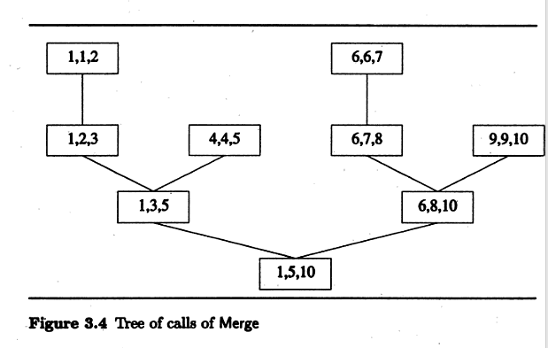

Slide 44
Merge Sort Analysis
If the time for the merging operations is proportional to ‘n’, then the computing time for merge sort is described by the recurrence relation.
T(n) = { a n=1,’a’ a constant
2T(n/2)+cn n>1, ‘c’ a constant.

Slide 45
Mergesort Analysis
Let T(N) be the running time for an array of N elements
Mergesort divides array in half and calls itself on the two halves. After returning, it merges both halves using a temporary array
Each recursive call takes T(N/2) and merging takes cn

Slide 46
Best/good Case
n
n/2
n/2
n/4
n/4
n/4
n/4
2
2
2
Total time: O(nlogn)

Slide 47
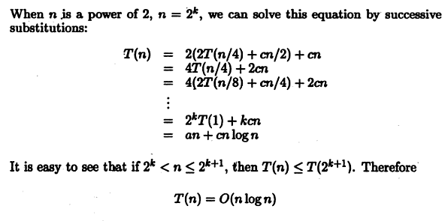
Best Case Time Complexity

Slide 48
Thank you one and all

